Slide 1

Data Wrangling and Analysis on Census Income
Apuyan, Viktor angelo B.
cpe22s3

Slide 2
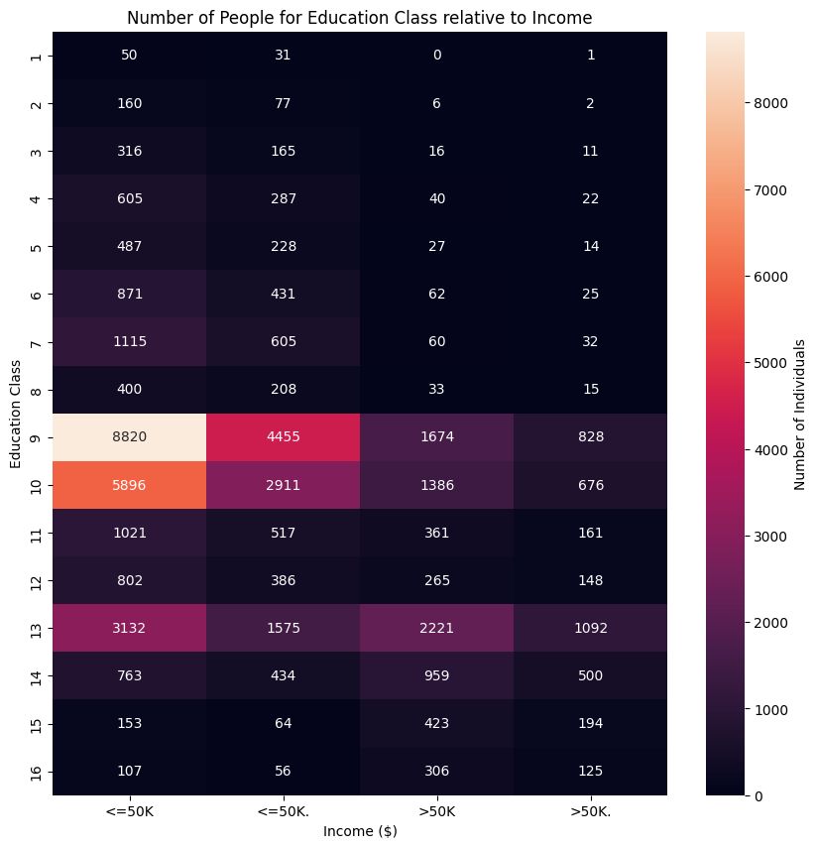
Education Class vs Income
- In the graph above, we can see that people with education classes of 9 & 10 make up the highest portion in the dataset. Also, we notice that people with education class of 14 to 16 proportionally usually make >50k as income in the statistics we have in the dataset, unlike lesser education classes where they usually make <=50k as income.

Slide 3
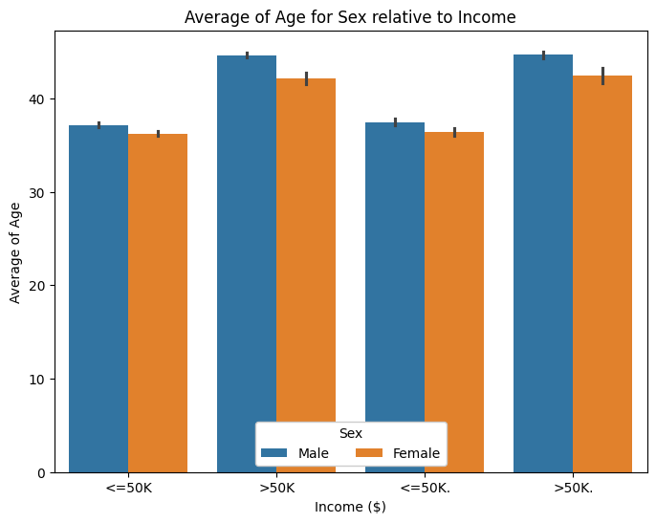
Average age of Sex Relative to Income
- The figure shows in general that the people with >50K has a higher average age than the ones with <=50K. And in both cases of income, we see that the male category has a little bit greater age average than the female category.

Slide 4
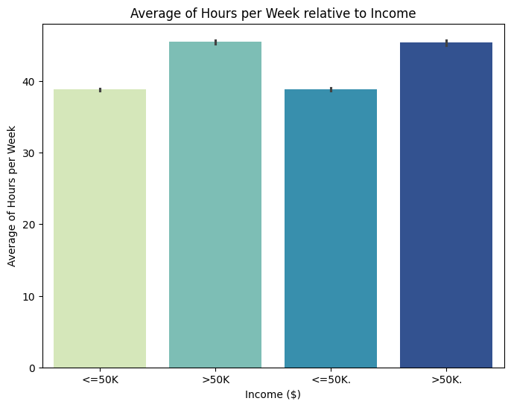
Average Hours per Week Relative to Income
- I notice here that the income grows directly with the average of work hours per week, which is a pretty reasonable and logical result.

